Slide 1
Some OOP Concepts in Java Programming
Bal Krishna Subedi
St. Xavier’s College
Prepared by Bal Krishna Subedi

Slide 2
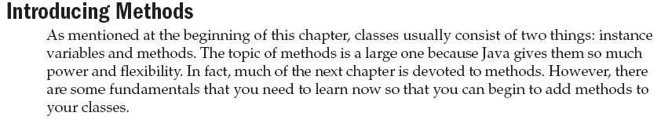
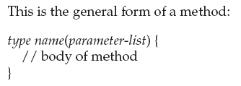
Prepared by Bal Krishna Subedi

Slide 3
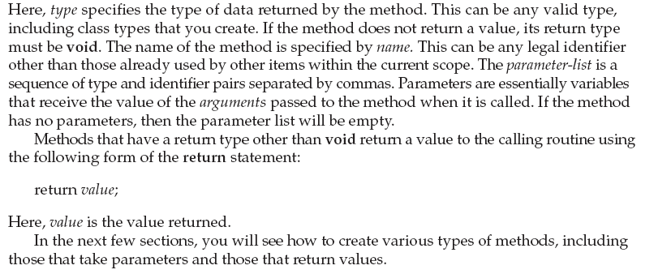
Prepared by Bal Krishna Subedi

Slide 4
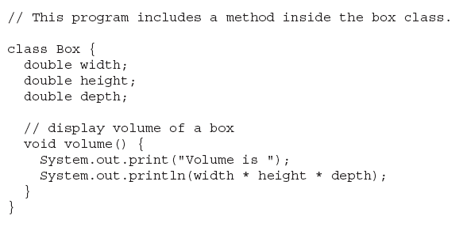
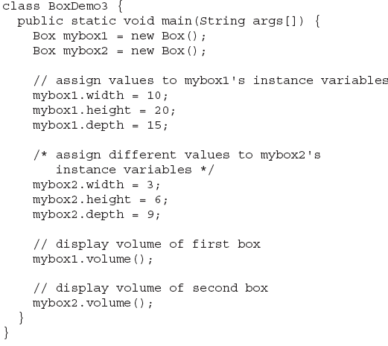
Adding the Methods to the class
Prepared by Bal Krishna Subedi

Slide 5

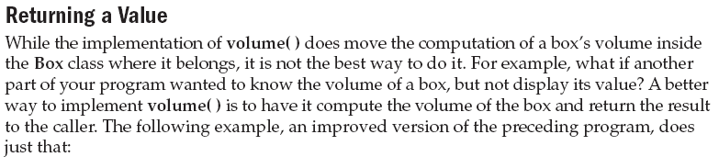
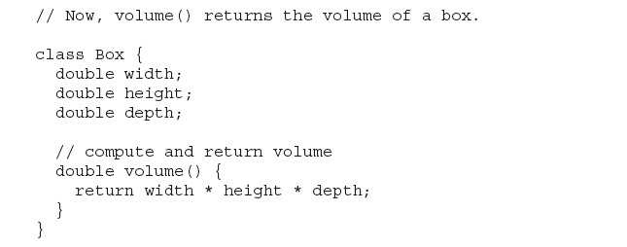
Prepared by Bal Krishna Subedi

Slide 6
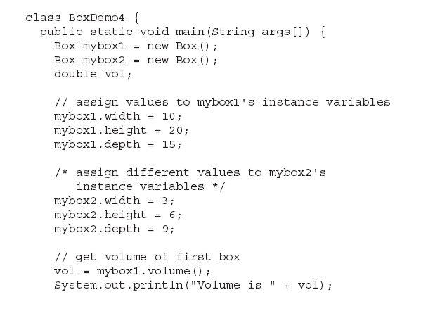
Prepared by Bal Krishna Subedi

Slide 7
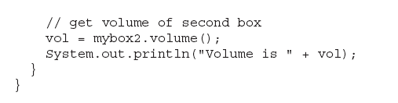
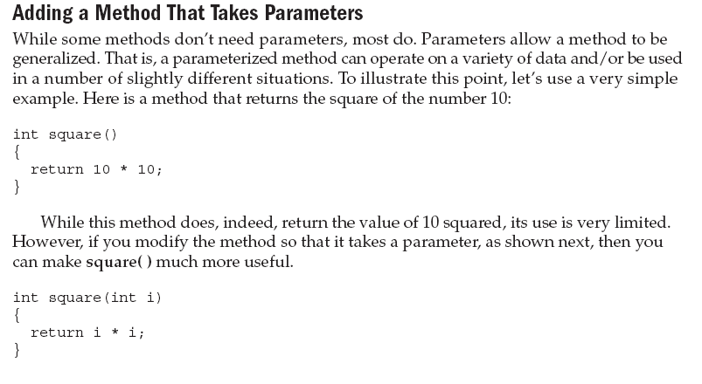
Prepared by Bal Krishna Subedi

Slide 8
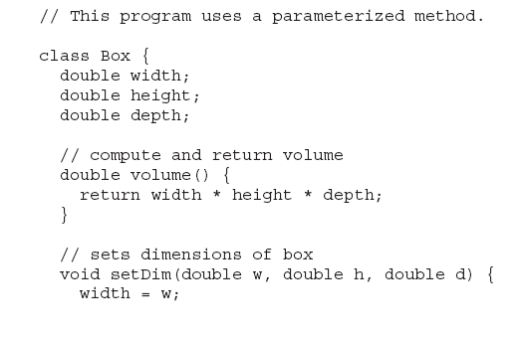
Method with Parameters Example
Prepared by Bal Krishna Subedi

Slide 9
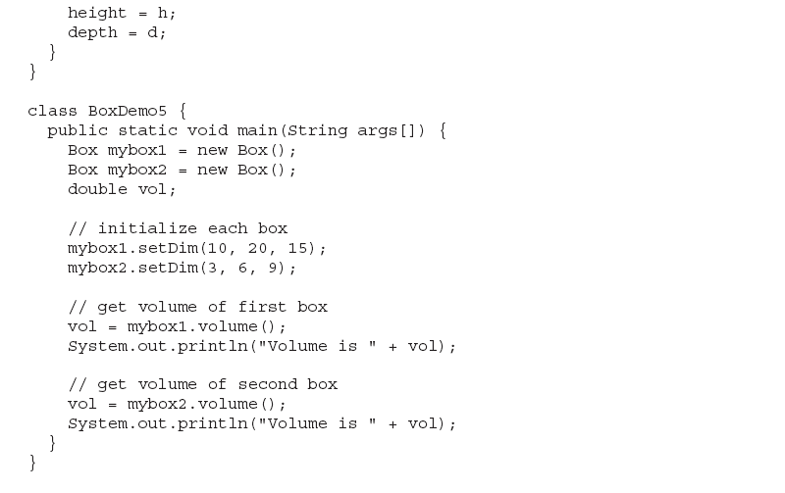
Prepared by Bal Krishna Subedi

Slide 10
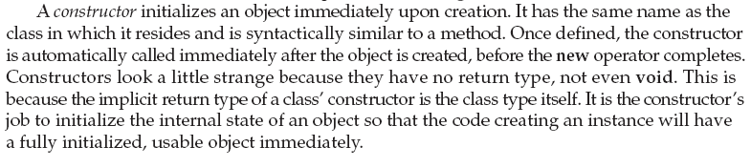
Constructors
Prepared by Bal Krishna Subedi

Slide 11
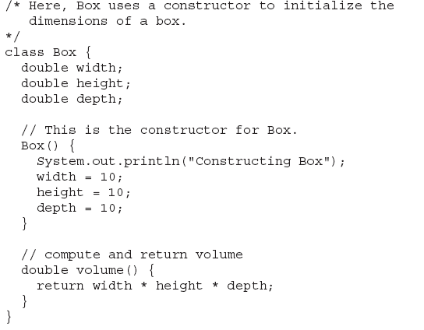
Prepared by Bal Krishna Subedi

Slide 12
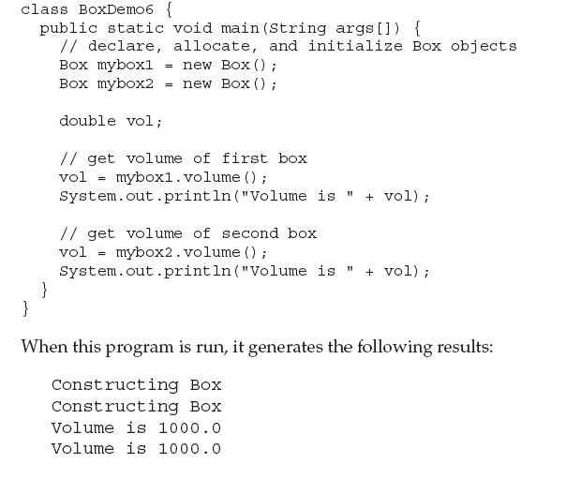
Prepared by Bal Krishna Subedi

Slide 13
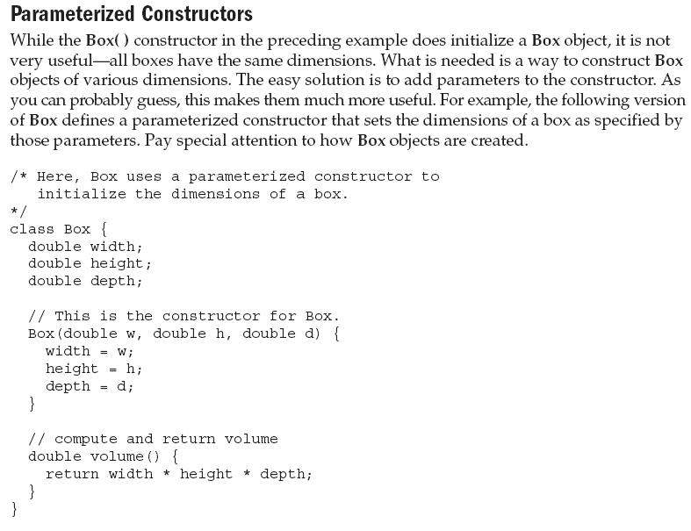
Prepared by Bal Krishna Subedi

Slide 14
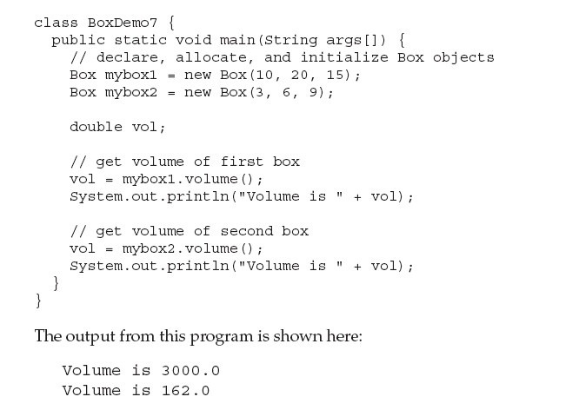
Prepared by Bal Krishna Subedi

Slide 15
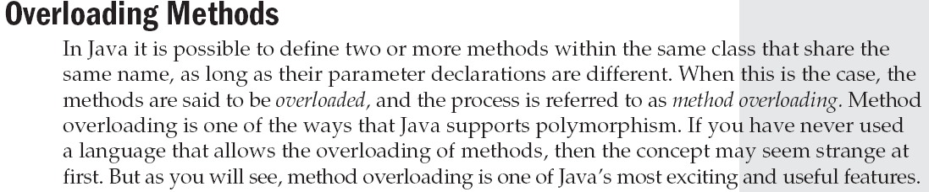
Prepared by Bal Krishna Subedi

Slide 16
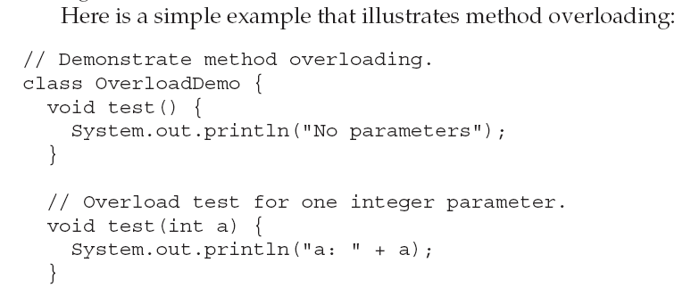
Prepared by Bal Krishna Subedi

Slide 17
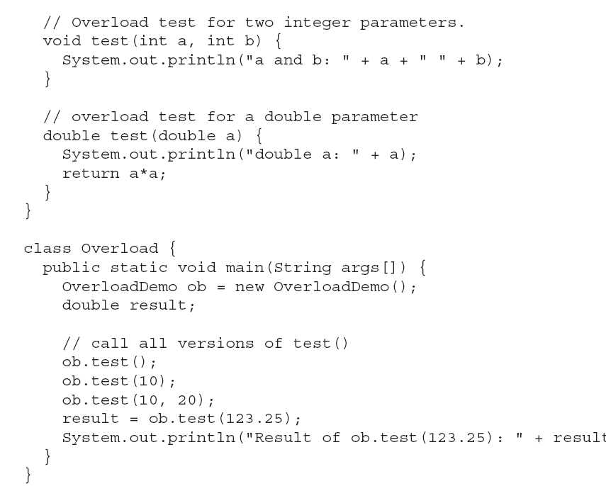
Prepared by Bal Krishna Subedi

Slide 18
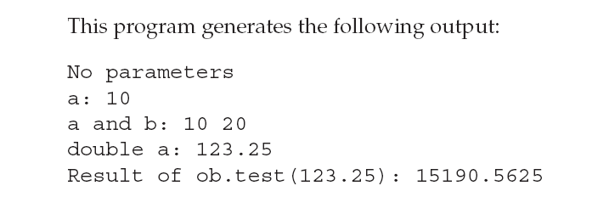
Prepared by Bal Krishna Subedi

Slide 19
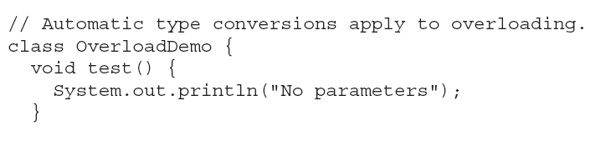
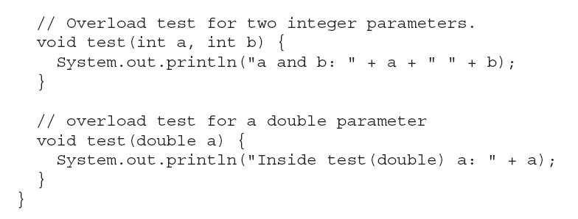
Another Methods Overloading Example
Prepared by Bal Krishna Subedi

Slide 20
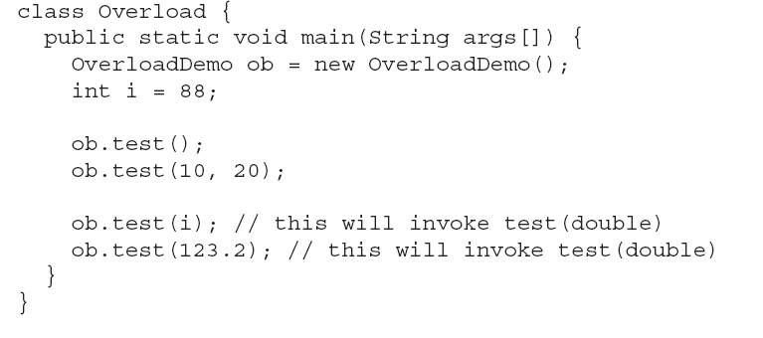
Prepared by Bal Krishna Subedi

Slide 21
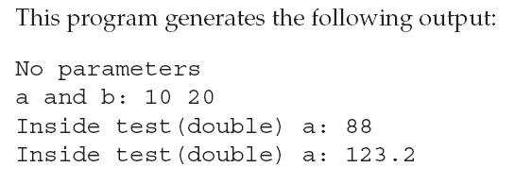
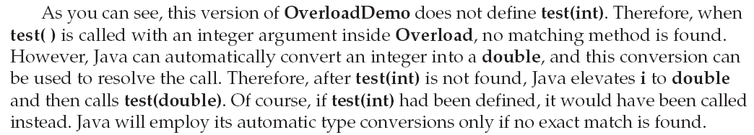
Prepared by Bal Krishna Subedi

Slide 22
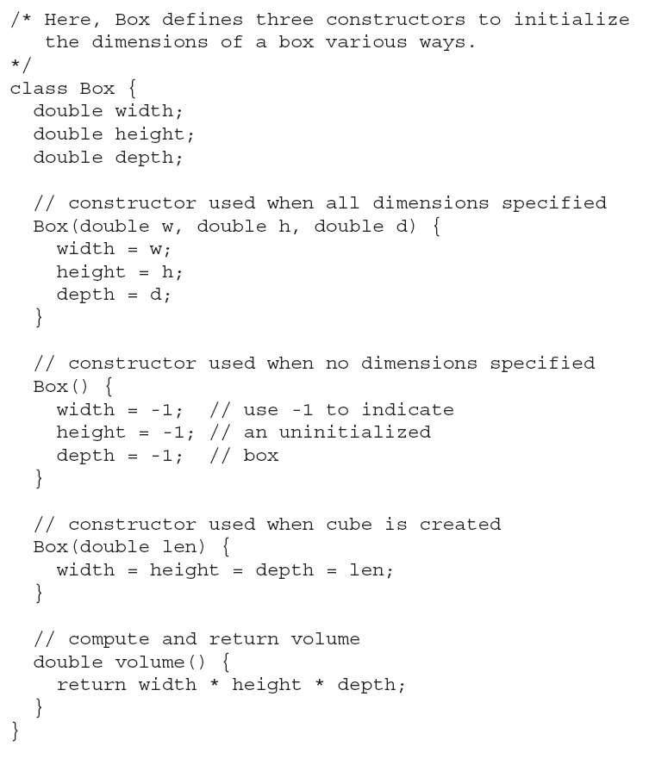
Constructor Overloading
Prepared by Bal Krishna Subedi

Slide 23
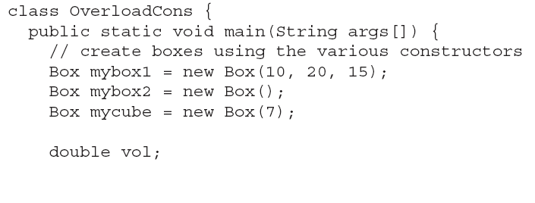
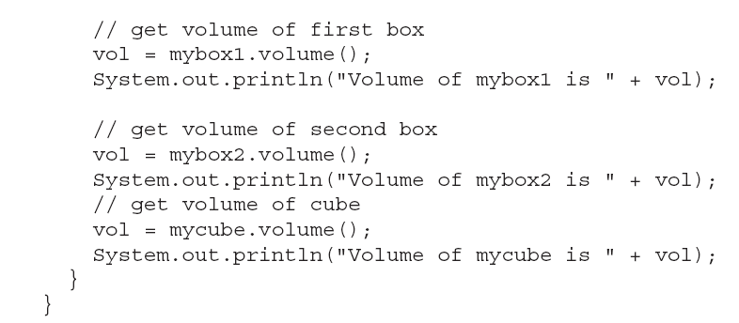
Prepared by Bal Krishna Subedi

Slide 24
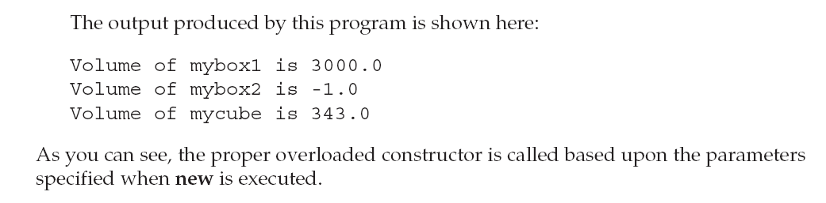
Prepared by Bal Krishna Subedi

Slide 25
Lab Assignment
Write a program to find volume of cube using method overloading.
Write a program to sum any two numbers/ strings using constructor overloading.
Prepared by Bal Krishna Subedi

